Slide 1






PROJECT ON:
FINANCE VOICE ASSISTANT
Where AI meets Finance 💸💵
BY: KALASH SHAH
202006100110040

Slide 2
TABLE OF CONTENTS
Definition and problem statement
Project Scope
Functional Requirements
Use case Diagram
Database Schema

Slide 3

PROBLEM DEFINITION
In the Fast and Modern world, where everyone is fond of shortcuts, a normal Personal Finance Management Tool maybe fall out of the requirements of people. Also, when people don’t have time to understand the whole web application including its pages features. Sometimes it may become problem for elderly people to fully understand the flow and functionalities of the Personal Finance management Tool including the design and style of the web application.

Slide 4




PROJECT OBJECTIVE
This project aims to solve all the above listed problem with ease to understand. The project aims to enhance the user interactivity. This project includes voice assistant which can help the user with many ways like finding the page, creating budget, adding amount in budget, deducting amount from budget, open specific budget, give investment advises, greet and basic interactions with the Users in English using their voices and understanding what they want to say.
Scope
The Scope of this System will be within India only.

Slide 5
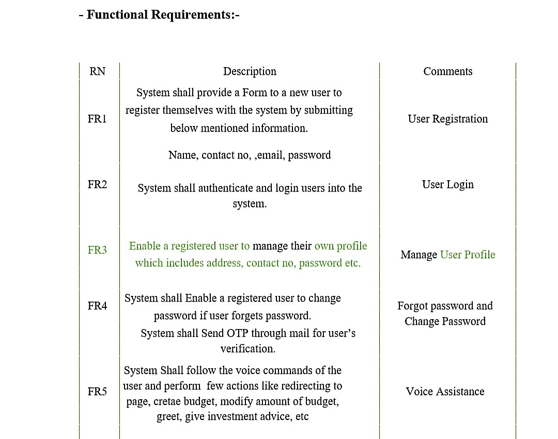


Slide 6
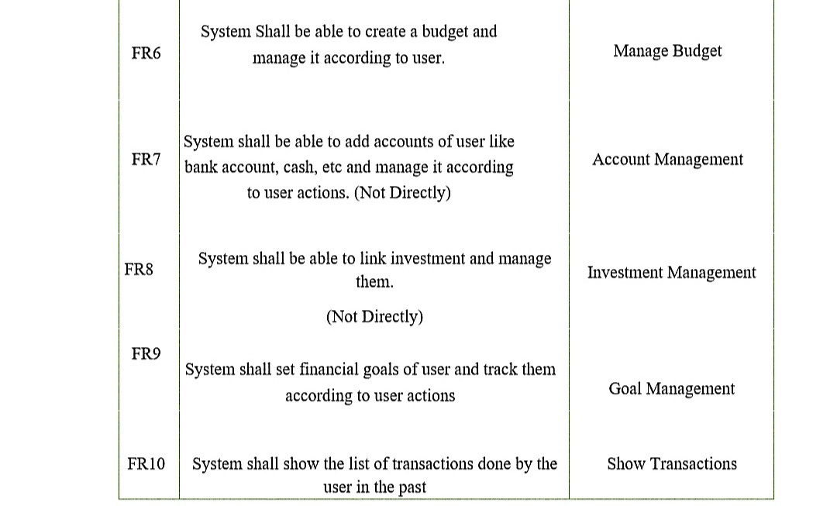

Slide 7

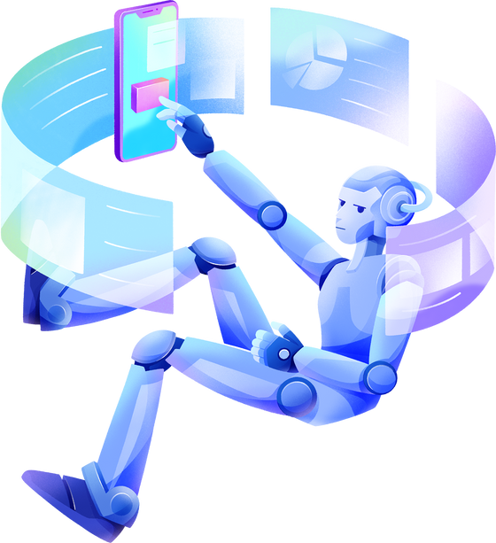


DATABASE SCHEMA
tbl_user { id[PK], username, email, password, number}
tbl_budget {bid[]PK, id[FK], name, amount, description, remaining, date }
FD : id -> username, email, password, number
tbl_records{ rid[PK], bid[FK], type,name, amount}
FD : bid -> id, name, amount, description, remaining, date

Slide 8

THANK YOU!

